Slide 1

Customer Management Database
Presented by: Baran YİĞİT – 201711071
Presented to: Roya CHOUPANI, Assist. Prof. Dr.
Irmak AKKUZULUOĞLU
Notes:
NOT:
Bu slayttaki resmi değiştirmek için resmi seçin ve silin. Sonra, yer tutucudaki Resimler simgesine tıklayarak kendi resminizi ekleyin.

Slide 2
Customer Management Database
Customer data management is the way in which you keep track of information you collect about customers.
A customer database is a collection of information about all the customers that have made a purchase from your business.
A customer database helps you improve customer retention, increase revenue and increase the value of each customer.

Slide 3
Customer data management can help you sort, search, and select clients that you have had previous contact with. Databases can also help you collect and act on sales leads. How you manage your clients and contacts will have lasting effects on the success or failure of your business.
Your database stores valuable information about your customers, such as name, e-mails and purchasing history. The database provides visibility over customers who are buying your products or services.

Slide 4
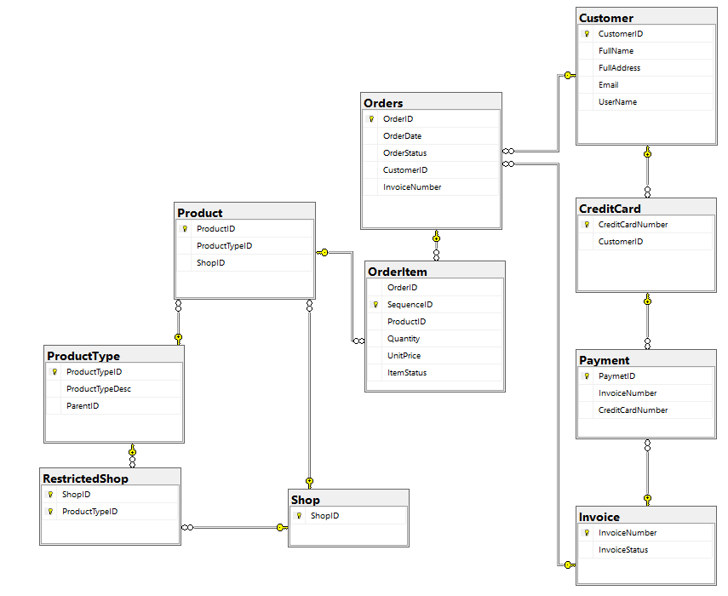
Customer Management Database Diagram

Slide 5
CreditCard Entity
Column Name | Data Type | Allow Nulls
CreditCardNumber(PK) | varchar(20) | No
CustomerID(FK) | int | No
Relationships:
Payment-CreditCard
CreditCard-Customer

Slide 6
Customer Entity
Column Name | Data Type | Allow Nulls
CustomerID(PK) | İnt | No
FullName | varchar(50) | No
FullAddress | varchar(50) | No
Email | varchar(50) | No
UserName | varchar(20) | No
Relationships:
Payment-CreditCard
Orders-Customer

Slide 7
Invoice Entity
Column Name | Data Type | Allow Nulls
InvoiceNumber(PK) | İnt | No
InvoiceStatus | varchar(20) | No
Relationships:
Orders-Invoice
Payment-Invoice

Slide 8
OrderItem Entity
Column Name | Data Type | Allow Nulls
OrderID(FK) | int | No
SequenceID(PK) | int | No
ProductID(FK) | int | No
Quantity | int | No
UnitPrice | decimal(8,2) | No
ItemStatus | varchar(20) | No
Relationships:
OrderItem-Order
OrderItem-Product

Slide 9
Orders Entity
Column Name | Date Type | Allow Nulls
OrderID(PK) | int | No
OrderDate | date | No
OrderStatus | varchar(20) | No
CustomerID(FK) | int | No
InvoiceNumber(FK) | int | No
Relationships:
OrderItem-Orders
Orders-Customer
Orders-Invoice

Slide 10
Payment Entity
Column Name | Data Type | Allow Nulls
PaymentID(PK) | int | No
InvoiceNumber(FK) | int | No
CreditCardNumber(FK) | varchar(20) | No
Relationships:
Payment-CreditCard
Payment-Invoice

Slide 11
Product Entity
Column Name | Data Type | Allow Nulls
ProductID(PK) | int | No
ProductTypeID(FK) | int | No
ShopID(FK) | İnt | No
Relationships:
OrderItem-Product
Product-ProductType
Product-Shop

Slide 12
ProductType Entity
Column Name | Data Type | Allow Nulls
ProductTypeID(PK) | int | No
ProductTypeDesc | varchar(500) | Yes
ParentID(FK) | int | Yes
Relationships:
RestrictedShop-ProductType
Product-ProductType

Slide 13
RestrictedShop Entity
Column Name | Data Type | Allow Nulls
ShopID(PK,FK) | int | No
ProductTypeID(PK,FK) | int | No
Relationships:
RestrictedShop-Shop
RestrictedShop-ProductType

Slide 14
Shop Entity
Column Name | Data Type | Allow Nulls
ShopID(PK) | int | No
Relationships:
Product-Shop
RestrictedShop-Shop

Slide 15
Creating Table
 | CREATE TABLE Customer
 | (
 | CustomerID INT NOT NULL IDENTITY(1,1),
 | FullName VARCHAR(50) NOT NULL,
 | FullAddress VARCHAR(50) NOT NULL,
 | Email VARCHAR(50) NOT NULL,
 | UserName VARCHAR(20) NOT NULL,
 | UNIQUE(Email),
 | UNIQUE(UserName),
 | PRIMARY KEY (CustomerID)
 | );

Slide 16
Creating Table
 | CREATE TABLE CreditCard
 | (
 | CreditCardNumber VARCHAR(20) NOT NULL,
 | CustomerID INT NOT NULL,
 | PRIMARY KEY (CreditCardNumber),
 | FOREIGN KEY (CustomerID) REFERENCES Customer(CustomerID)
 | );

Slide 17
Creating Table
 | CREATE TABLE ProductType
 | (
 | ProductTypeID INT NOT NULL IDENTITY(1,1),
 | ProductTypeDesc VARCHAR(500),
 | ParentID INT DEFAULT NULL,
 | PRIMARY KEY (ProductTypeID),
 | FOREIGN KEY (ParentID) REFERENCES ProductType(ProductTypeID)
 | );

Slide 18
Creating Table
 | CREATE TABLE Shop
 | (
 | ShopID INT NOT NULL IDENTITY(1,1),
 | ShopName VARCHAR(20) NOT NULL,
 | PRIMARY KEY (ShopID)
 | );

Slide 19
Creating Table
 | CREATE TABLE Product
 | (
 | ProductID INT NOT NULL IDENTITY(1,1),
 | ProductTypeID INT NOT NULL,
 | ProductName VARCHAR(20) NOT NULL,
 | Price DECIMAL(8,2) NOT NULL,
 | ProductDesc VARCHAR(500),
 | Colour VARCHAR(20),
 | Size VARCHAR(20),
 | ShopID INT NOT NULL,
 | PRIMARY KEY (ProductID),
 | FOREIGN KEY (ProductTypeID) REFERENCES ProductType(ProductTypeID)
 | FOREIGN KEY (ShopID) REFERENCES Shop(ShopID)
 | );

Slide 20
Creating Table
 | CREATE TABLE RestrictedShop
 | (
 | ShopID INT NOT NULL,
 | ProductTypeID INT NOT NULL,
 | PRIMARY KEY (ShopID, ProductTypeID),
 | FOREIGN KEY (ShopID) REFERENCES Shop(ShopID),
 | FOREIGN KEY (ProductTypeID) REFERENCES ProductType(ProductTypeID)
 | );

Slide 21
Creating Table
 | CREATE TABLE Invoice
 | (
 | InvoiceNumber INT NOT NULL IDENTITY(1,1),
 | InvoiceDate DATE NOT NULL DEFAULT GETDATE(),
 | InvoiceStatus VARCHAR(20) NOT NULL,
 | PRIMARY KEY (InvoiceNumber)
 | );

Slide 22
Creating Table
 | CREATE TABLE Payment
 | (
 | PaymentID INT NOT NULL IDENTITY(1,1),
 | InvoiceNumber INT NOT NULL,
 | CreditCardNumber VARCHAR(20) NOT NULL,
 | PRIMARY KEY (PaymentID),
 | FOREIGN KEY (InvoiceNumber) REFERENCES Invoice(InvoiceNumber)
 | FOREIGN KEY (CreditCardNumber) REFERENCES CreditCard(CreditCardNumber)
 | );

Slide 23
Creating Table
 | CREATE TABLE Orders
 | (
 | OrderID INT NOT NULL IDENTITY(1,1),
 | OrderDate DATE NOT NULL DEFAULT GETDATE(),
 | OrderStatus VARCHAR(20) NOT NULL,
 | CustomerID INT NOT NULL,
 | InvoiceNumber INT NOT NULL,
 | PRIMARY KEY (OrderID),
 | FOREIGN KEY (CustomerID) REFERENCES Customer(CustomerID)
 | FOREIGN KEY (InvoiceNumber) REFERENCES Invoice(InvoiceNumber)
 | );

Slide 24
Creating Table
 | CREATE TABLE OrderItem
 | (
 | OrderID INT NOT NULL,
 | SequenceID INT NOT NULL IDENTITY(1,1),
 | ProductID INT NOT NULL,
 | Quantity INT NOT NULL,
 | UnitPrice DECIMAL(8,2) NOT NULL,
 | ItemStatus VARCHAR(20) NOT NULL,
 | PRIMARY KEY (SequenceID),
 | FOREIGN KEY (OrderID) REFERENCES Orders(OrderID),
 | FOREIGN KEY (ProductID) REFERENCES Product(ProductID)
 | );

Slide 25
Inserting Into
 | INSERT INTO dbo.Customer
 | (
 | FullName, FullAddress, Email,UserName
 | )
 | VALUES
 | (‘Murat', 'Blk 123 Sunshine Avenue', ‘murat@gmail.com', ‘MRAT','),
 | (‘Roya', 'Blk 225 North East CDC', ‘roya@gmail.com', ‘Roya436),
 | (‘Irmak', 'Blk 112 Singapore', ‘irmak28@gmail.com', ‘Irmak212’), (‘Baran', 'Blk 556 Serangon Drive’, ‘baran09@hotmail.com’, ‘baran85’),
 | Select *
 | from dbo.Customer

Slide 26
Inserting Table
 | INSERT INTO dbo.CreditCard
 | (
 | CreditCardNumber, CustomerID
 | )
 | VALUES
 | ('5775311057578442', 1 ),
 | ('5775311334578442', 1),
 | ('5775324333458435', 2),
 | ('5775344234618782', 3),
 | Select *
 | from dbo.CreditCard

Slide 27
Some queries about database

Slide 28
Find customers that have one paid for at least an item from each restricted shop.
SELECT c.FullName
FROM Customer c
JOIN Orders o ON o.CustomerID = c.CustomerID
JOIN CreditCard cc ON cc.CustomerID = c.CustomerID
JOIN OrderItem oi ON oi.OrderID = o.OrderID
JOIN Invoice i ON i.InvoiceNumber = o.InvoiceNumber
JOIN Product p ON p.ProductID = oi.ProductID
JOIN RestrictedShop rs ON rs.ProductTypeID = p.ProductTypeID
WHERE i.InvoiceStatus = 'paid'
GROUP BY c.FullName
HAVING count(distinct rs.ShopID) = (SELECT count(*)
FROM RestrictedShop)
;

Slide 29
Find the 3 bestselling product type ids in terms of product quantity sold. The products of concerned have to be ordered and paid.
SELECT TOP 3
(oi.ProductID) , SUM(oi.Quantity) AS TotalQuantity
FROM ProductType pt
INNER JOIN Product p ON p.ProductTypeID = pt.ProductTypeID
INNER JOIN OrderItem oi ON oi.ProductID = p.ProductID
INNER JOIN Orders o ON o.OrderID = oi.OrderID
INNER JOIN Invoice i ON i.InvoiceNumber = o.InvoiceNumber
WHERE i.InvoiceStatus = 'paid'
GROUP BY oi.ProductID
ORDER BY TotalQuantity DESC
;

Slide 30
Given a customer by an email address, returns the product ids that have been ordered and paid by this customer but not yet shipped.
SELECT p.ProductID
FROM Product p
INNER JOIN OrderItem oi ON p.ProductID = oi.ProductID
INNER JOIN Orders o ON o.OrderID = oi.OrderID
INNER JOIN Customer c ON c.CustomerID = o.CustomerID
INNER JOIN Invoice i ON i.InvoiceNumber = o.InvoiceNumber
WHERE oi.ItemStatus <> 'shipped' AND i.InvoiceStatus = 'paid'
AND o.CustomerID = (SELECT CustomerID
FROM Customer
WHERE Email = 'baran09@hotmail.com')
;

Slide 31
Conclusion
A customer database is the collection of information that is gathered from each person. The database may include contact information, like the person's name, address, phone number, and e-mail address. The database may also include past purchases and future needs.
Effective customer data management provides several business benefits:
Boost in sales through better knowledge of customer needs.
Higher efficiency of business processes by eliminating duplication and junk data collection.
Compliance and data security through standardisation and centralisation of data.

Slide 32
Thanks for listening.
Questions?

